Slide 1

Crafting ColdFusion Applications Like An Architect
Adobe ColdFusion Summit 2016

Slide 2

Crafting ColdFusion
Applications Like An Architect

Slide 3

Who am I
Shirak Avakian
Enterprise Solution Architect
QBI LLC
shirakavakian@gmail.com
@shirakavakian

Slide 4
Who am I
Shirak Avakian
Enterprise Solution Architect
QBI LLC
shirakavakian@gmail.com
@shirakavakian
No Facebook

Slide 5
Subjects to Cover
Questions to answer
Software architect vs building architect
Software architect vs code

Slide 6
Subjects to cover
Questions to answer
Software architect vs building architect
Software architect vs code

Slide 7
Questions to Answer
How do I start a project?
How do I find resources?
How do I collect business requirements?
How to design my business entities?
Do I need services/API?
Do I need framework?
How to make my code cleaner?
Is ColdFusion got me covered?
How to prepare my demo for upper management.?
Any thing else?

Slide 8
Questions to Answer
Read Initial specification
Visualize
Know your environment
Meet with users ( not managers )
Write down any manual process
Draft your solutions
How do I start a project?
How do I find resources?
How do I collect business
requirements?
How to prepare my demo for
upper management.?
Timeline/budget
Define/Find resources
Craft your first demo

Slide 9
Questions to Answer
Read Initial specification
Visualize
Know your environment
How do I start a project? How do I find resources? How do I collect business requirements? How to prepare my demo for upper management.
Meet with users ( not managers )
Write down any manual process
Draft your solutions
Timeline/budget
Define/Find resources
Craft your first demo

Slide 10
Questions to Answer
How to design my business entities?
Normalize Backend (database) SQL/No SQL
Do not overwhelm your OOP
Generate Table Objects / DAO
Do I need services/API?
Yes if you want to serve somewhere else
Yes if you want to make your application loosely coupled
No for else
Do I need framework?
Yes (period)
No if you want to demo proof of concepts
No if you want to embarrass yourself
How to make my code cleaner?
Follow one coding standers and be consistence
Write comments
Clean up your code

Slide 11
Questions to Answer
How to design my business entities?
Normalize Backend (database) SQL/No SQL
Do not overwhelm your OOP
Do I need services/API?
Yes if you want to serve somewhere else
No for else
Do I need framework?
Yes (period)
No if you want to embarrass yourself
How to make my code cleaner
Follow one coding standers and be consistence
Generate Table Objects / DAO
Yes if you want to make your application loosely coupled
Write comments
Clean up your code
No if you want to demo proof of concepts

Slide 12
Understanding Software Architect

Slide 13
Understanding Software Architect

Slide 14
Software Architect
Software architecture refers to the high level structures of a software system, the discipline
of creating such structures, and the documentation of these structures.
Facts
Software architecture is about making fundamental structural choices which are costly to change once implemented.
Software architecture is all about structures not technology
Software architecture must have long term vision
Business requirement is a key factor to start software architect
Communication in software architect play big role on final outcome
Software architect should represent your system without compromises.

Slide 15
Software Architect
Software architecture refers to the high level structures of a software system, the discipline
of creating such structures, and the documentation of these structures.
Facts
Software architecture is about making fundamental structural choices which are costly to change once implemented.
Software architecture is all about structures not technology
Software architecture must have long term vision
Business requirement is a key factor to start software architect
Communication in software architect play big role on final outcome
Software architect should represent your system without compromises.

Slide 16
Software architecture start point

Slide 17
Software architecture start point
1- Step 1
Get the business requirements
Meet with Network administrator
Meet with dba
Sit down with actual employee (not a manager) and try write down all manual processes
2- Step 2
Putting things together
Choosing database
Choosing Technology
Cloud vs in-house

Slide 18
Software architect vs building architect
Best way to explain the digital world is by
Comparing with physical world

Slide 19

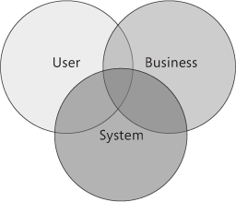
Software Architect vs Building Architect
Building Architecture: Is both the process and the product of planning, designing,
and constructing buildings and other physical structures.
Software Architecture: Is both the process and the product of planning, designing,
and coding softwares and other physical/digital requirements.

Slide 20
Software architect vs building architect
Building Architecture: Is both the process and the product of planning, designing, and constructing buildings and other physical structures.
Software Architecture: Is both the process and the product of planning, designing, and coding softwares and other physical/digital requirements.

Slide 21
Let us compare side by side

Slide 22
Software architect vs building architect
Steps | Building | Software
1 | Meet the owner go over his/her vision | Meet with the department to go over their business requirements
2 | Lot size, city code, structure, square footage | Domain, application type, load, budget
3 | Provide blue print | High level diagram of application process

Slide 23
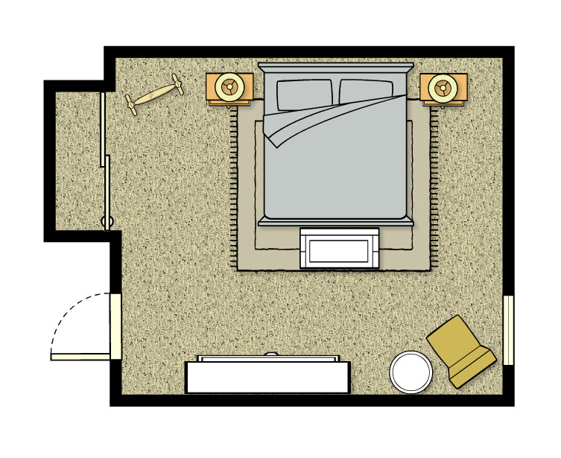
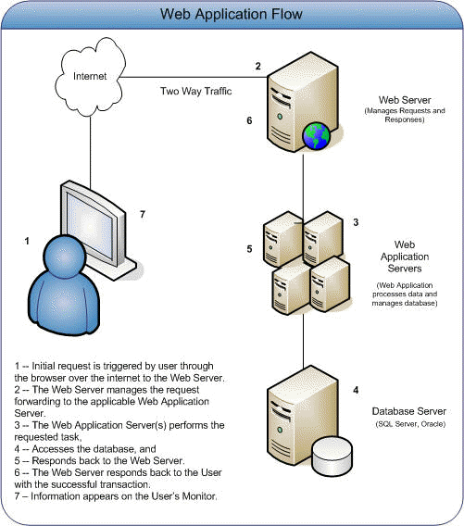
Software Architect vs Building Architect
Building room floor plan
Application servers diagram

Slide 24
Software architect vs building architect
Building room floor plan
Application servers diagram

Slide 25
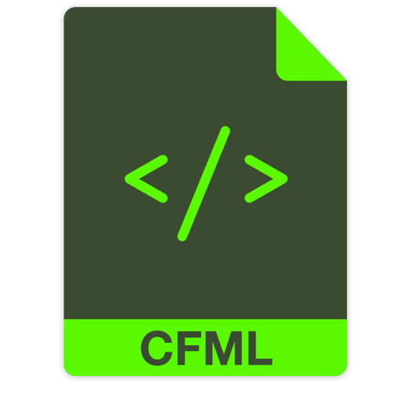
Let us convert the room to ColdFusion code

Slide 26
Let us Convert the room
to ColdFusion Code

Slide 27
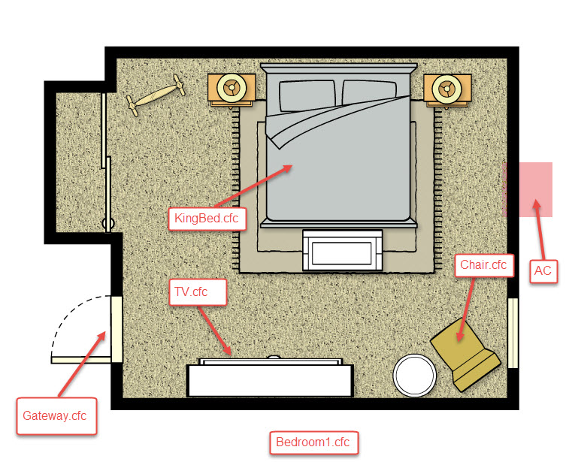
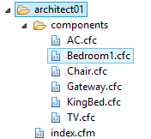
Software Architect vs Building Architect
How do I know which method belong to which component?
Ask the component! If it make sense then it belongs to it
Example: HasChair() method makes total sense when you ask the Bedroom1.cfc
Can you ask Bedroom1 HasCar()? NO
See Architect 01 source code

Slide 28
Software architect vs building architect
See Architect 01 source code

Slide 29
Software Architect vs Building Architect
How do I know which method belong to which component?
Ask the component! If it make sense then it belongs to it
Example: HasChair() method makes total sense when you ask the Bedroom1.cfc
Can you ask Bedroom1 HasCar()? NO
See Architect 01 source code

Slide 30
Software architect vs building architect
How do I know which method belong to which component?
Ask the component! If it make sense then it belongs to it
Example: HasChair() method makes total sense when you ask the Bedroom1.cfc
Can you ask Bedroom1 HasCar()? NO
See Architect 01 source code

Slide 31
Software Architect vs Building Architect
Structure
Bedrom1
AC
Furniture
KingBed
Operations
getACType
TV
getChairColor()
Chair
hasChair()
hasTV()
hasBed()
hasFurniture()
Service Factory
Building
Packages
Business functions/objects
Services
See Architect 02 source code

Slide 32
Software architect vs building architect
Structure
Bedrom1
AC
Furniture
KingBed
Operations
getACType
TV
getChairColor()
Chair
hasChair()
hasTV()
hasBed()
hasFurniture()
Service Factory
Building
Packages
Business functions/objects
Services
See Architect 02 source code

Slide 33
Software Architect vs Code

Slide 34
Software architect vs code

Slide 35
Software Architect vs Code
Repository/Database
OOP (Object Oriented Programing)
SOA (Service Oriented Architect)
UI

Slide 36
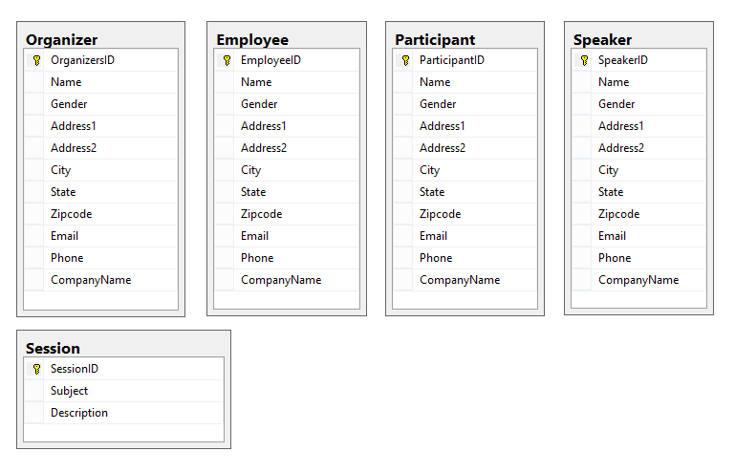
Software Architect vs Code
1- Database/Repository 1 of 3
Database normalization, or simply normalization, is the process of organizing the columns (attributes) and tables (relations) of a relational database to minimize
data redundancy.(Wikipedia)

Slide 37
Software architect vs code
1- Database
Normalize/schema/user defined types
Store procedures / views
2- OOP (Object Oriented Programing)
It is all about objects
Business Entities vs Table Objects/Beans vs View Model
Inheritance
Repository
AutoGen/ORM
DAL
3- SOA ( Service Oriented Architect )
CSOA ( Classic Services Oriented Architect )
SFOA ( Service Factory Oriented Architect )
POA (Package Oriented Architect )
Services
3- MVC Frameworks
The Model
The Controller
The View
UI

Slide 38
Software architect vs code
Database normalization,
or simply normalization, is the
process of organizing the columns
(attributes) and tables (relations) of
a relational database to minimize
data redundancy.(Wikipedia)
Repository - Database

Slide 39
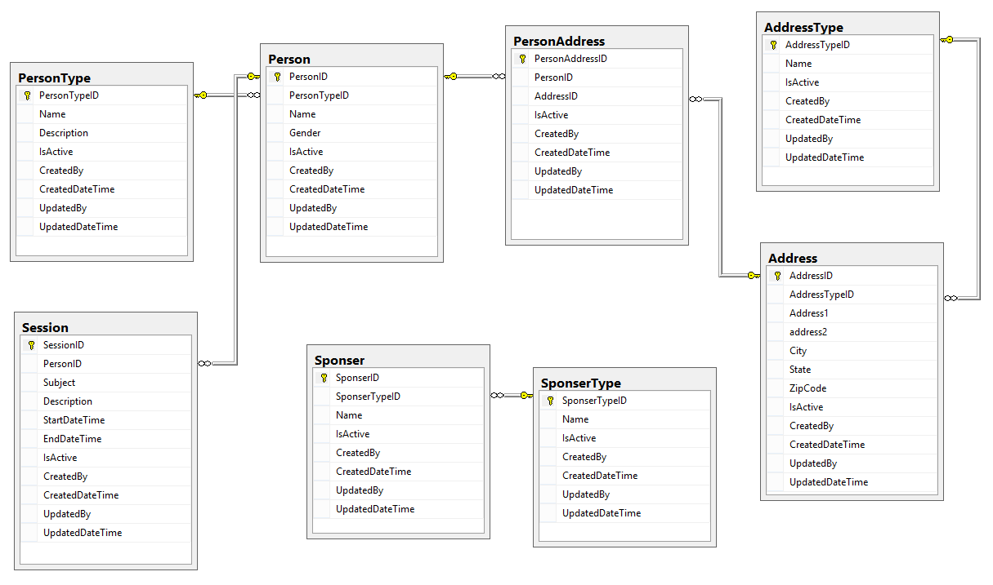
Software Architect vs Code
1- Database/Repository 2 of 3
Database Best Practices
1- Normalize your database
2- Create separate SQL authentication
3- Create schemas
4- Create user defined type
5- Use Store procedures & views
6- Prefix store procedures with usp
7- Don’t use plural form for tables names
8- Always create diagrams
9- Use constrains & foreign key’s
10- Use SQL Identity Increment
11- Define your primary keys
12- Always have common fields (columns)

Slide 40
Software architect vs code
Best Practices
1- Normalize your database
2- Create separate SQL authentication
3- Create schemas
4-Create user defined type
5- Use Store procedures & views
6- Prefix store procedures with usp
7- Don’t use plural form for tables names
8- Always create diagrams
9- Use constrains & foreign key’s
10- Use SQL Identity Increment
11- Define your primary keys
12- Always have common fields (columns)
Repository - Database

Slide 41
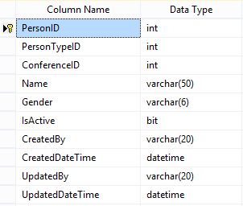
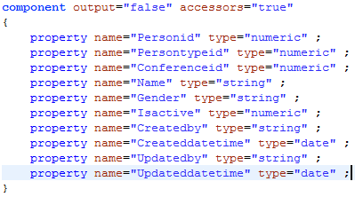
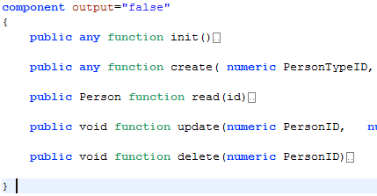
Software Architect vs Code
2- OOP (Object Oriented Programing) 1 of 4
Person Table
Person.cfc (Table Object)
PersonDAO.cfc (Data Access Object)

Slide 42
Software architect vs code
Person Table
Person.cfc (Table Object)
Repository – OOP- AutoGenerated/Table objects/ DAO
PersonDAO.cfc (Data Access Object)

Slide 43
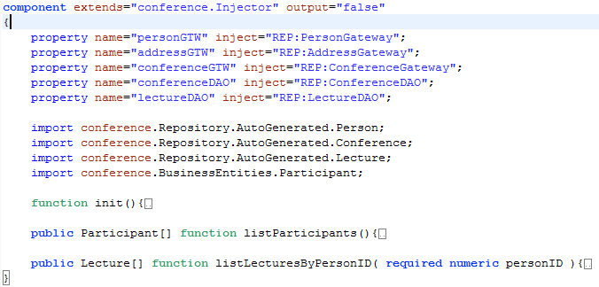
Software Architect vs Code
2- OOP (Object Oriented Programing) 2 of 4
DAO (Data Access Object) vs DAL (Data Access Layer)
PersonDAL.cfc (Data Access Layer)
PersonDAO.cfc (Data Access Object)
1- No Inheritance
2- Represent single table
3- No Injectors
4-Output array of table object or query
1- Inheritance
2- Represent multiple table
3- Injectors
4-Output array of Business entities or Procedure struct or query

Slide 44
Software architect vs code
DAO (Data Access Object) vs DAL (Data Access Layer)
PersonDAO.cfc (Data Access Object)
PersonDAL.cfc (Data Access Layer)
Repository – OOP- DAL-Business Entities
1- No Inheritance
2- Represent single table
3- No Injectors
4-Output array of table object or query
1- Inheritance
2- Represent multiple table
3- Injectors
4-Output array of Business entities or Procedure struct or query

Slide 45
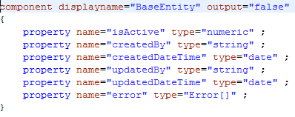
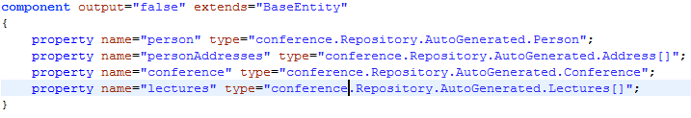
Software Architect vs Code
2- OOP (Object Oriented Programing) 3 of 4
BusinessEntities is predefined objects represent services return type.

Slide 46
Software architect vs code
BusinessEntites is predefined objects represent services return type.
Repository – OOP- Business Entities

Slide 47
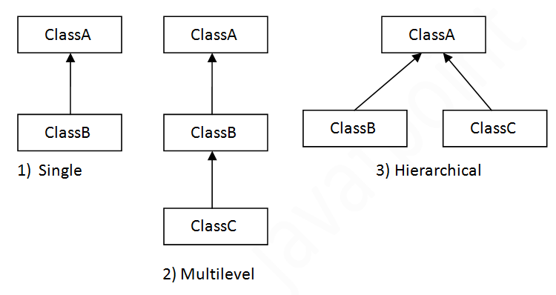
Software Architect vs Code
2- OOP (Object Oriented Programing) 4 of 4
Inheritance is a mechanism in which one object acquires all the properties and behaviors of parent object. The idea behind inheritance is that you can create new classes that are built upon existing classes. (www.javatpoint.com/inheritance-in-java)

Slide 48
Software architect vs code
Inheritance is a mechanism in which one object acquires all the properties and behaviors of parent object. The idea behind inheritance is that you can create new classes that are built upon existing classes. (www.javatpoint.com/inheritance-in-java)
Repository – OOP- Inheritance

Slide 49
Software Architect vs Code
3- SOA (Service Oriented Architect) 1 of 4
CSOA ( Classic Services Oriented Architect )
SFOA ( Service Factory Oriented Architect )
POA (Package Oriented Architect )
 | Advantages | Disadvantages
1 | Service Reusability | Increased Overhead
2 | Maintainability | Complex Service Management
3 | Reliability | High Investment Cost
4 | Location Independence
5 | Improved Software Quality
6 | Platform Independence
7 | Increased Productivity
A service-oriented architecture (SOA) is an architectural pattern in computer software design in which application components provide services to other components via a communications protocol, typically over a network. The principles of service-orientation are independent of any vendor, product or technology. (https://en.wikipedia.org/wiki/Service-oriented_architecture)

Slide 50
Software architect vs code
A service-oriented architecture (SOA) is an architectural pattern in computer software design in which application components provide services to other components via a communications protocol, typically over a network. The principles of service-orientation are independent of any vendor, product or technology. (https://en.wikipedia.org/wiki/Service-oriented_architecture)
 | Advantages | Disadvantages
1 | Service Reusability | Increased Overhead
2 | Maintainability | Complex Service Management
3 | Reliability | High Investment Cost
4 | Location Independence
5 | Improved Software Quality
6 | Improved Software Quality
7 | Platform Independence
8 | Increased Productivity
Services-COA ( Classic Oriented Architect )

Slide 51
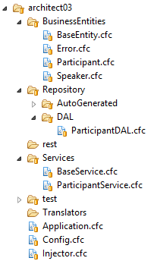
Software Architect vs Code
SOA (Service Oriented Architect) 2 of 4
Classic Service Oriented Architect
UI-Model
ParticipantService
ParticipantService
ParticipantDAL
ParticipantDAL
Database
listParticipant()
listParticipants()
See Architect 03 source code

Slide 52
Software architect vs code
Classic Service Oriented Architect
UI-Model
ParticipantService
ParticipantService
ParticipantDAL
ParticipantDAL
Database
listParticipant()
listParticipants()
Services-COA ( Classic Service Oriented Architect )
See Architect 03 source code

Slide 53
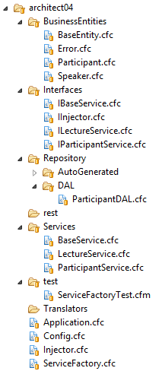
Software Architect vs Code
SOA (Service Oriented Architect) 3 of 4
Service Factory Oriented Architect
UI-Model
Service Factory
LectureService
ParticipantService
Validation
LectureDAL
ParticipantDAL
OtherDAL
See Architect 04 source code

Slide 54
Software architect vs code
Service Factory Oriented Architect
Service Factory
UI-Model
ParticipantService
LectureService
LectureDAL
ParticipantDAL
Validation
OtherDAL
Services-SFOA (Service Factory Oriented Architect )
See Architect 04 source code

Slide 55
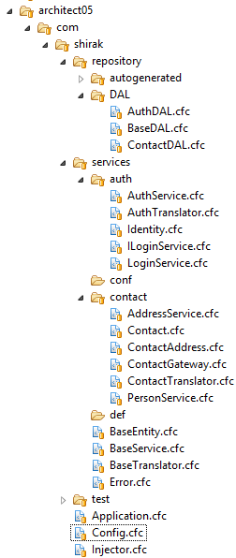
Software Architect vs Code
SOA (Service Oriented Architect) 4 of 4
Package Oriented Architect
UI/Model
Contact Service Package (Contact Gateway)
Auth Service Package (Auth Gateway)
Address Service
Person Service
Login Service
Contact DAL
Auth DAL
See Architect 05 source code

Slide 56
Software architect vs code
Package Oriented Architect
UI/Model
Contact Service Package (Contact Gateway)
Address Service
Person Service
Auth Service Package (Auth Gateway)
Login Service
Contact DAL
Auth DAL
Services-SFOA (Package Oriented Architect )
See Architect 05 source code

Slide 57
Software Architect vs Code
4 – UI/UX User Interface/User Experience 1 of 4
UI
Services
Repository
Things to consider
Complete Isolation
Loosely coupled
Pluggable
Modular
CFML
CFC
SQL
jQuery
AngularJS
3rd Party API
File System
See Architect 05 source code

Slide 58
3- MVC Frameworks
The Model
The Controller
The View
UI

Slide 59




Software Architect vs Code
4 – UI/UX User Interface/User Experience 2 of 4
an application framework consists of a software framework used by software developers to implement
the standard structure of an application. (Wikipedia)
Why Framework
ColdFusion Frameworks
Keep your team focus on business layer
Everyone in your team will follow same structure
Already tested
Save time and money
Easy to train new hire
Separation of concern
Coldbox
Framework One
CFWheels
Fusebox
See Architect 06 source code
See Architect 05 source code

Slide 60
Software architect vs code
UI - MVC Framework
an application framework consists of a software framework used by software developers to implement
the standard structure of an application. (Wikipedia)
Why Framework
ColdFusion Frameworks
Keep your team focus on business layer
Everyone in your team will follow same structure
Already tested
Save time and money
Easy to train new hire
Separation of concern
Coldbox
Framework One
CFWheels
Fusebox
MVC Framework (Model-View-Controller
See Architect 06 source code

Slide 61
Software Architect vs Code
4 – UI/UX User Interface/User Experience 3 of 4
Model view controller (MVC) is a very useful and popular design pattern.
Unfortunately it's also one of the hardest to truly understand.
Controller
View
Model
The controller provides model data to the view,
and interprets user actions such as button clicks.
The controller depends on the view and the model.
The model represents the data. The model does NOT depend on the controller or the view.
The view displays the model data, and sends user actions (e.g. button clicks) to the controller.
See UI source code

Slide 62
Software architect vs code
UI - MVC Framework
Model view controller (MVC) is a very useful and popular design pattern.
Unfortunately it's also one of the hardest to truly understand.
The Model
The model represents the data, and does
nothing else. The model does NOT depend
on the controller or the view.
MVC Framework (Model-View-Controller
The Controller
The controller provides model data to the view,
and interprets user actions such as button clicks.
The controller depends on the view and the model.
The View
The view displays the model data, and sends user
actions (e.g. button clicks) to the controller.
See UI source code

Slide 63
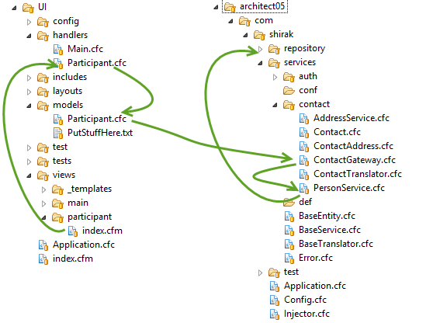

Software Architect vs Code
4 – UI/UX User Interface/User Experience 4 of 4
UI & Service on same server
http://myapp/index.cfm/Participant
URL request to render the view through the handler
Handler request the data from the model
Model create service instance
Model makes a call to the service
Handler gets the data from the model
Handler generates the view model (RC)
Handler render the page (View)
See Architect 05 source code

Slide 64
Software architect vs code
UI - MVC Framework
UI & Service on same server
http://myapp/index.cfm/Participant
URL request to render the view through the handler
Handler request the data from the model
Model create service instance
Model makes a call to the service
Handler gets the data from the model
Handler generates the view model (RC)
Handler render the page (View)
MVC Framework (Model-View-Controller

Slide 65
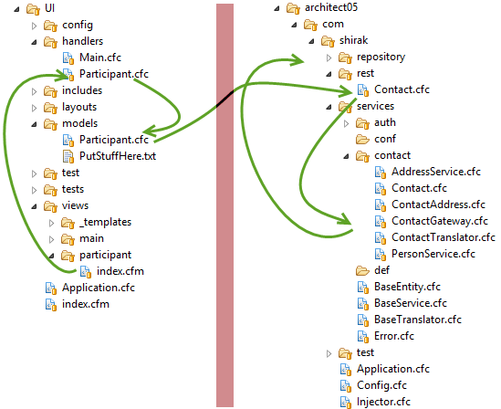

Software Architect vs Code
4 – UI/UX User Interface/User Experience 4 of 4
Different servers
Server 1
Server 2
http://myapp/index.cfm/Participant
URL request to render the view through the handler
Handler request the data from the model
Model create service instance
Model makes a call to the REST service
Handler gets the data from the model
Handler generates the view model (RC)
Handler render the page (View)

Slide 66
Thank You
Questions?
Resources
Don’t leave hold of your common sense. Think about what you’re doing and how the technology can enhance it.
Don’t think about technology first.
(Esther Dyson)
https://acrobat.adobe.com
http://www.scandit.com/
http://developers.itextpdf.com
Source Code
https://github.com/cfclick/CFSummit2016

Slide 67
Software architect vs code
UI - MVC Framework
Different servers
Server 1
Server 2
http://myapp/index.cfm/Participant
URL request to render the view through the handler
Handler request the data from the model
Model create service instance
Model makes a call to the REST service
Handler gets the data from the model
Handler generates the view model (RC)
Handler render the page (View)
MVC Framework (Model-View-Controller

Slide 68
Software architect vs code
View
Controller
Model
+ Services (API)
See Architect 02 source code

Slide 69
Software architect vs code
1- Normalize database
2- Create your repository components (Data access, ORM)
3- Test Case
4- Define your business entities
5- Create translator
6- Create Services
7- Test Case
8- Define your packages
9- Define your Gateways
10- Test Case
11- Create API, REST
12- Test Case
13- Create your MVC Model
14- Translator for View Model
15- Test Case
16- Controller
17- View

Slide 70
Resources
Questions
Source code available on github
THANK YOU

